Slide 1
The Spring Social Network
By Georgi Semkov
Mario Donchev

Slide 2
Features
The basic stuff you expect from any social media:
Register and log in
Find and add friends
Create posts to share with your friends
Comment on those posts

Slide 3
Technology
All Java!*
Front-End:
JSP
Bootstrap
Back-end:
Spring Boot:
Spring JPA
Spring Security
Spring Web
PostgreSQL
*And a little bit of markup and CSS of course

Slide 4
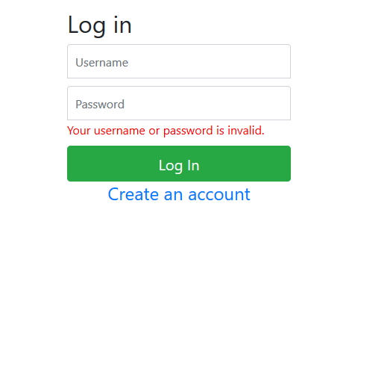
The network itself

Slide 5
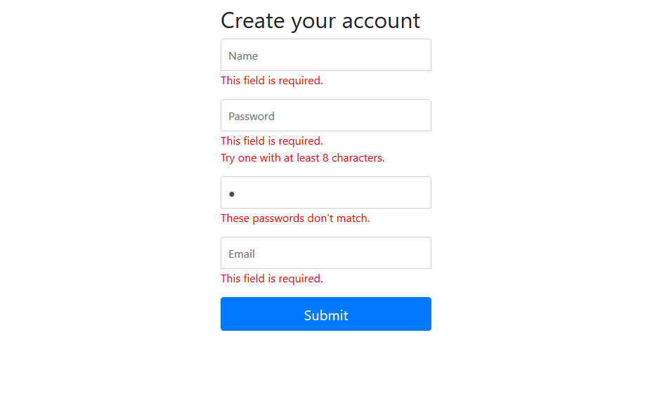
The network itself

Slide 6
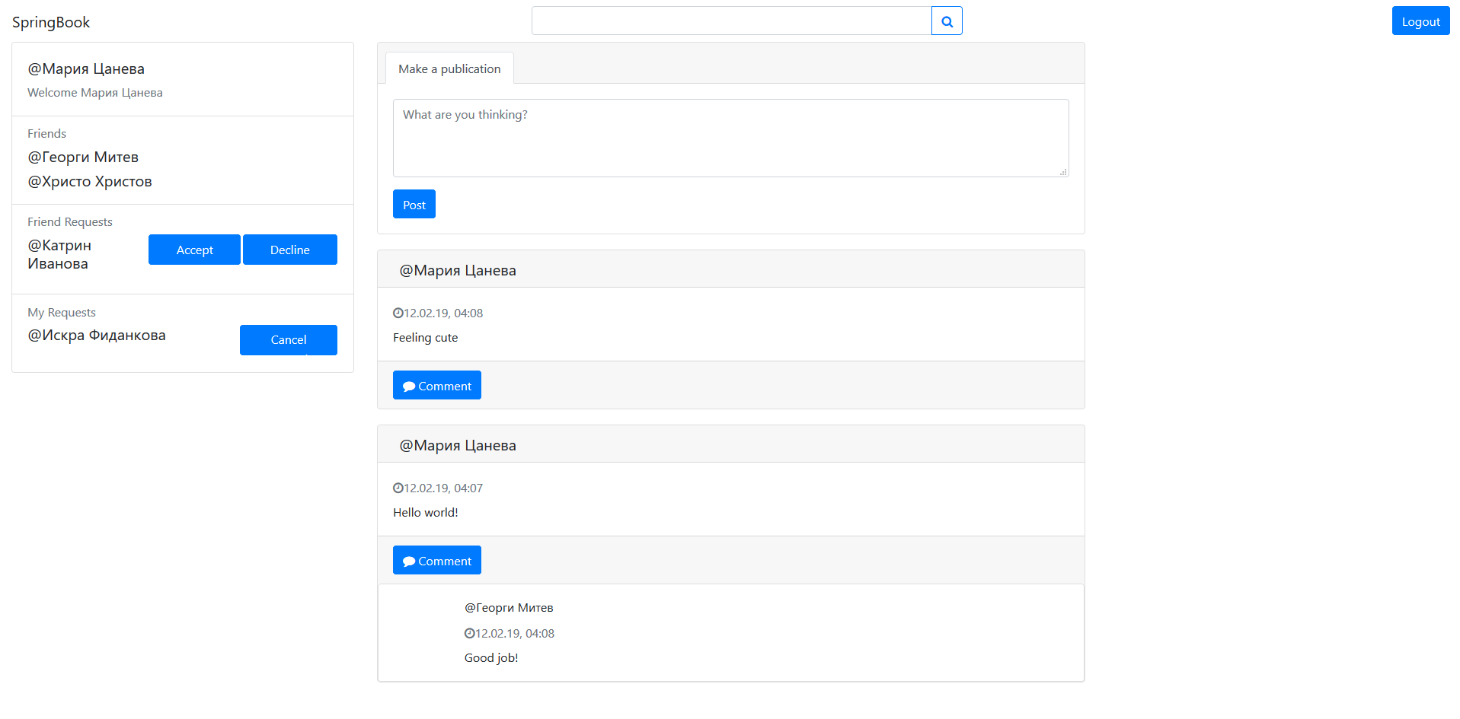
The network itself

Slide 7
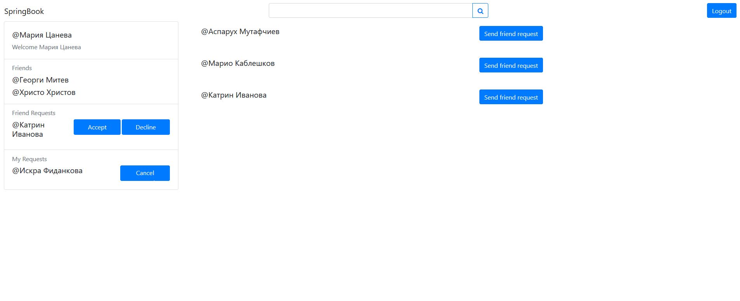
The network itself

Slide 8
TODO
Admin UI – Delete whoever and whatever you want without SQL queries
Attach media to your posts
Groups
Live streaming notifications with web sockets
Likes!

